Slide 1
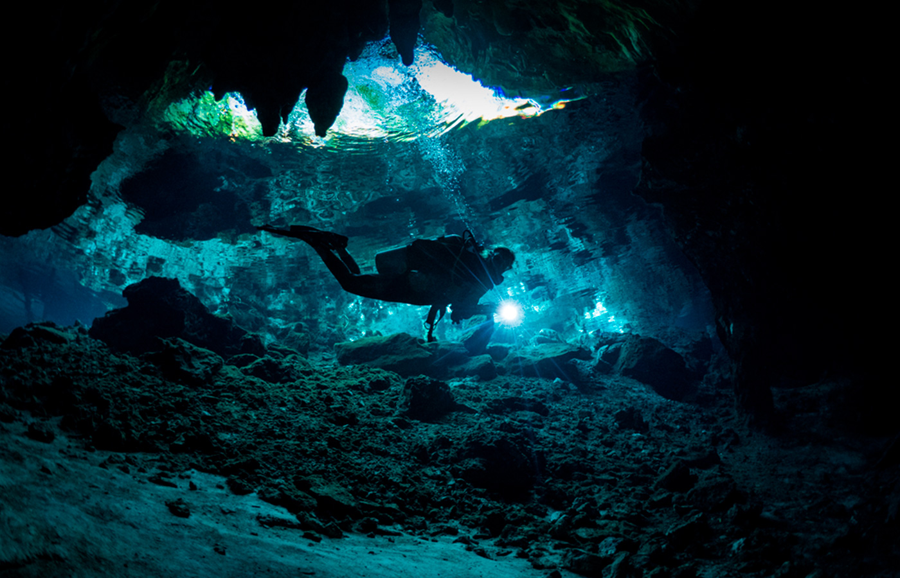

Cave diving
An extremely dangerous sport
A presentation by Leo Bunea
Notes:
I’m going to present to you: Cave Diving! A Sport where you must be fearless

Slide 2
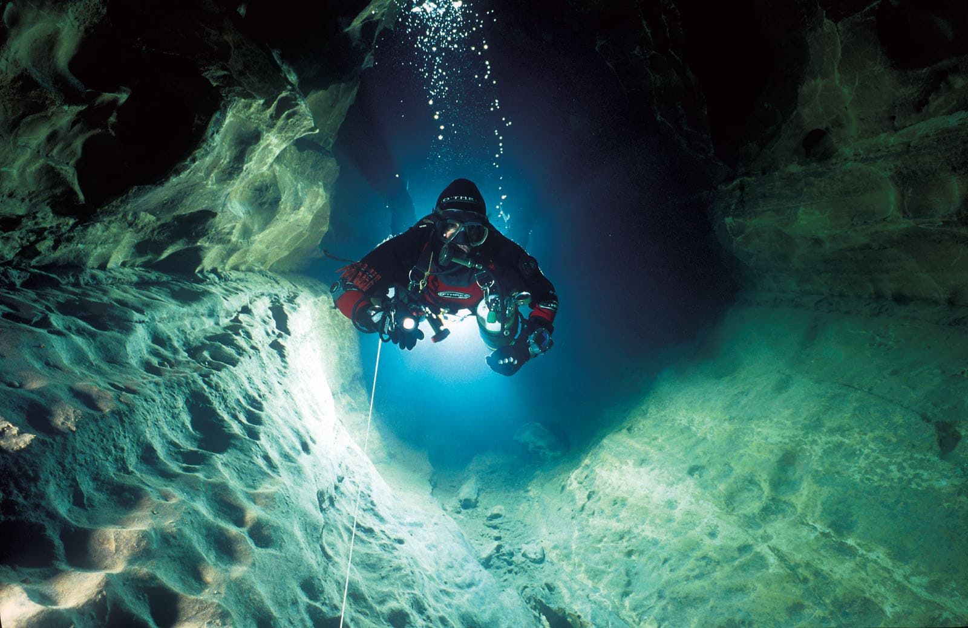
What is cave diving?
The combination of diving and caving. Both are very dangerous activities.
Diving in a water-filled cave
Equipment needed:
sling cylinders
Rebreathers
Side mounted, backplate and wing harness
Air tanks (usually ones designed for exploration)
Line markers (called “cookies”)
Lights, diver propulsion vehicle
Notes:
First of, what is cave diving? Combi → diving + caving … just read whats there

Slide 3
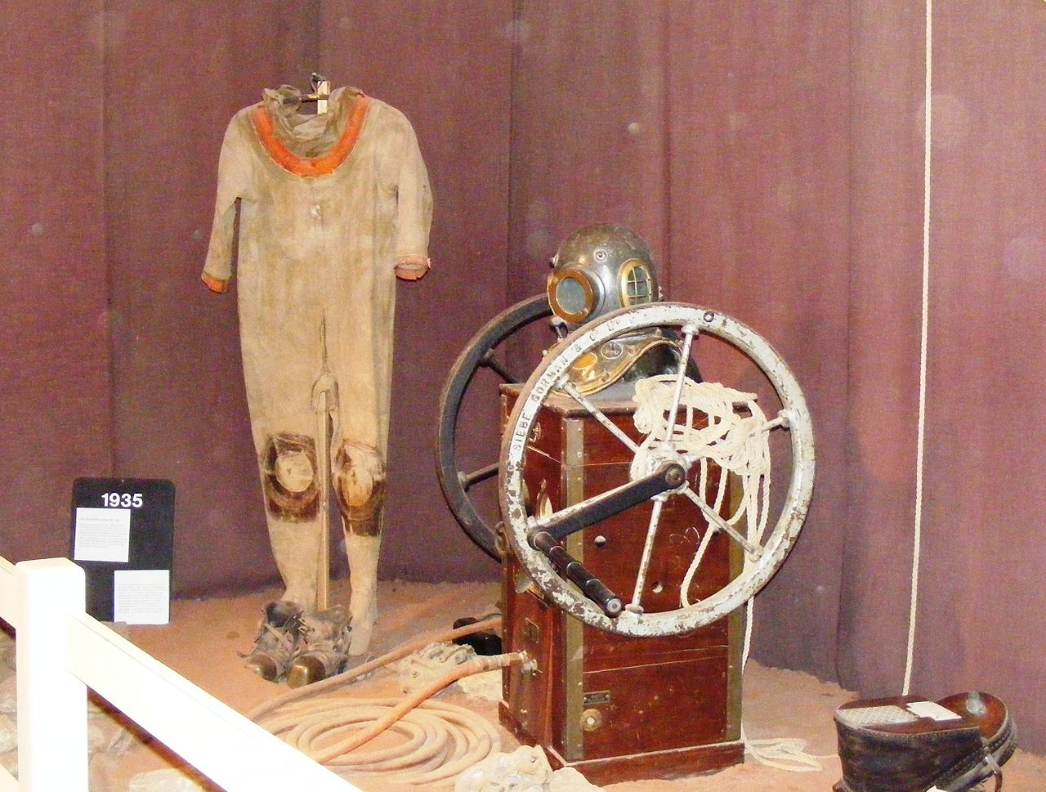
How cave diving became a sport
Cave Diving Group (officially founded in 1946, UK):
Founded by Graham Balcombe
1st successful Dive by Jack Sheppard (John Arthur) in 1936, prior attempts failed due to faulty home-made diving gear.
Cave diving increased in popularity in the US in the 1970s

Slide 4
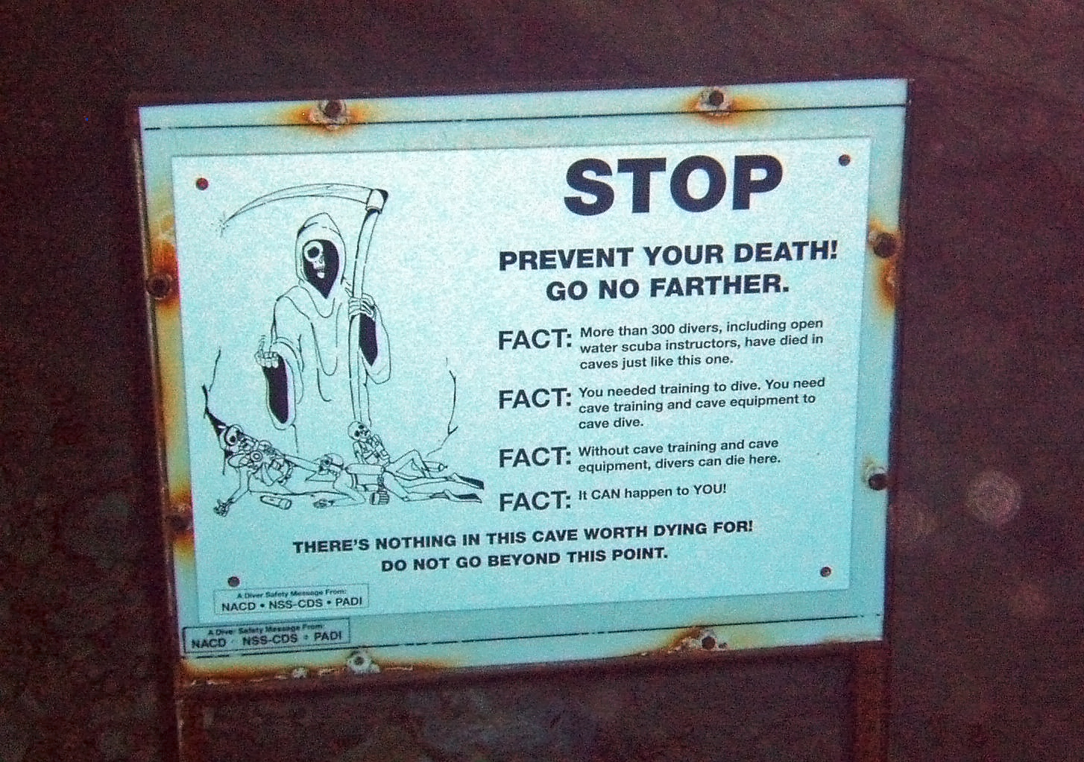
Risks
Navigation through the cave is hard
Visibility can range from clear to non-existent
Water Currents
Many have died due to faulty equipment or running out of oxygen
Common sign seen in caves

Slide 5
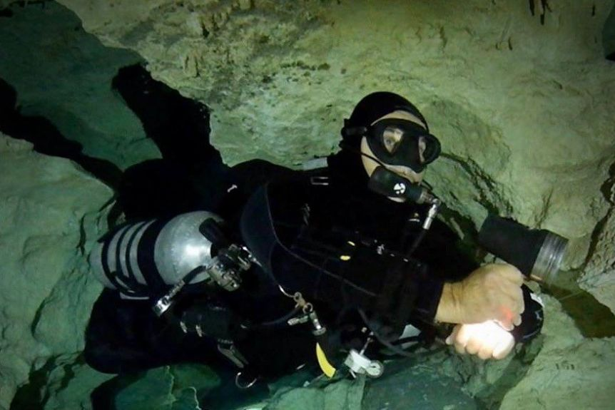
Skills required to cave dive
Open water diving skills: buoyancy control, oxygen supply problems, …
Training in regular caving: ability to navigate in total darkness, line management, ….
YOU NEED TO BE AN EXPERIENCED DIVER AND CAVER TO ATTEMPT CAVE DIVING

Slide 6

Stay safe!
Who knows what lurks down there!

